Slide 1
CO APCD Advisory Committee
March 12, 2024

Slide 2
Agenda
Opening Announcements
Operational Updates
HCPF 5-Year CO APCD Evaluation & Discussion
Public Reporting
Public Comment and Member Open Discussion

Slide 3
Open Committee Positions
Pharmacy benefit manager
An organization that processes insurance claims or certain aspects of employee benefit plans for a separate entity

Slide 4
Chair and Vice Chair Elections
Open for nominations/elections every two years
Current committee chairs can continue to serve (no term limit)
Role of Chair/Vice Chair:
Assist CIVHC and Executive Director with agenda setting for meetings
Facilitate quarterly meetings (Vice Chair fills in for Chair as needed)
Support CIVHC with Committee recruitment
Assist with other items as needed, including but not limited to:
Review of meeting materials
Letters of support from the Committee to external entities
Advisement regarding state and federal legislation impacting operations of the CO APCD

Slide 5
Next Steps for Nominations/Elections
Minimum of one year on the Committee to be nominated
CIVHC will send out call for nominations by 3/15
Submit nominations (self-nomination or otherwise) via email by 3/19
Will send out a voting mechanism if we receive multiple nominations for the same role
New chair positions will work with current chairs to assist with June meeting with full transition starting September 2024

Slide 6
Operational Updates
Kristin Paulson, JD, MPH
CEO and President
Pete Sheehan
VP of Client Solutions & State Initiatives

Slide 7
National Level APCD Update
U.S. House and Senate are pressing for more data transparency in health care, especially for Medicare Advantage; CMS recent RFI on MA data needs.
ASPE and RAND just completed a first pass of aligned APCD application.
AHRQ still expressing interest in pursuing a national APCD; still have legislation in the House. Some interest in exploring this in the Senate as well.
DOL and others, including national employers, are desperate for solutions to give them the information needed to move health care costs.
APCD’s have entered recent conversations with SAMHSA, ONC, VA, OPM, and others.
Multiple state-run efforts around aligned applications, measure development, data.

Slide 8
Multi-State Data Set Initiative (Pilot)
Goals:
Demonstrate ability to integrate APCD data across states.
Determine use cases that can be addressed with aligned data.
Initial development of aligned application, data governance, data use agreements.
Begin research into needed tech requirements.
Explore funding to stand up larger multi-state data set.

Slide 9
Identified MSDI Use Cases
Providing critical information for large, self-funded employers.
State to state modeling and evaluation of:
Medicaid policy, state insurance mandates, equity issues in access and outcomes, quality and affordability measures, and more.
Post-market pharmaceutical surveillance.
Long COVID and COVID-complication research and treatment.
Chronic disease prevalence, burden, and management.
Payment reform research and efficacy evaluation.
Rare disease research and orphan drug development and monitoring.

Slide 10
Multi-State Data Set Initiative (Pilot)
Progress to date:
MOUs in place with CO, ME, VA for pilot work. Interest in participation from several other states.
Target use cases identified through focus group and partner interviews.
Initial development of aligned application (building off ASPE/RAND work published 10/23), data governance, data use agreements.
Finalizing crosswalk of the three state DSGs; awaiting finalization of data sharing agreements to bring the data together in line with the crosswalk.
Ongoing funding conversations from public and private funders.
Pilot completion ~10-12 wks, testing with focus group researchers to follow.

Slide 11
FY 23 Scholarship – Summary as of 2/29/2024
Information about the Scholarship can be found here:
https://www.civhc.org/scholarship/
Applications Fully Approved
15 projects have been approved totaling $303,902 of the $500,000 total available, 60.7% of the annual funds
Pending Projects
Currently there is 1 project in review totaling $9,687
Counting pending projects, $313,589 has been applied for, 62.7% of the annual funds
7 potential projects that have not been submitted with a potential of ~$150,000 requested in scholarship funding
$186,411 – remaining funds available for this fiscal year

Slide 12
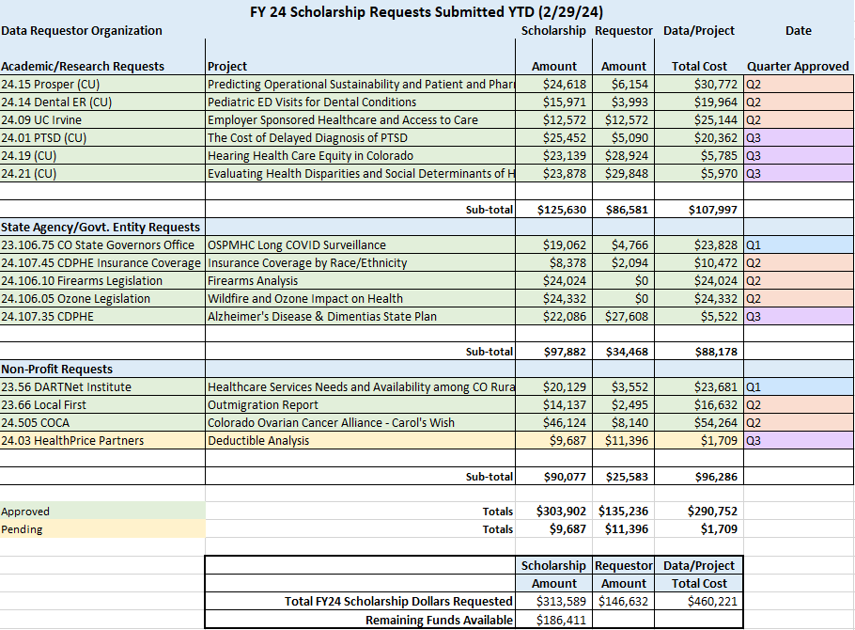
FY 23-24 Scholarship – Summary as of 2/29/2024

Slide 13
FY 23-24 Scholarship – Summary as of 2/29/2024

Slide 14
Tiered Pricing Model Background
Administrator of the CO APCD for eleven years.
Other than annual adjustments to CIVHC’s hourly rate, there have been no major changes to our pricing model in the last five years.
Our prices have fallen behind the current market rate for access to similar data and services.
CIVHC conducted a market analysis to review fees and models in place with APCDs in different states and data companies nationally.
Tiered models, in different forms, are in use by many other organizations.
A tiered pricing model was recommended by a DU team who evaluated our current client base and existing prices.

Slide 15
Tiered Pricing Model Purpose
Update CIVHC’s fee structure, bringing it on par with other APCDs and similar data warehouses to ensure long-term sustainability.
Implement a model that provides access to data and services in an equitable manner:
Organizations that have greater resources pay higher fees than others
Smaller organizations, such as small non-profits, students, legislators & local governments, pay lower fees

Slide 16
CIVHC’s Current Pricing Model
The same pricing model applies to all data requestors.
Small-to-medium sized non-profits, government entities, and researchers can apply for CO APCD Scholarship funding to have a portion of their costs subsidized. Annual appropriation of $500k administered by HCPF.
* Ranges are provided to assist with estimating costs, and are based on a review of projects from fiscal year 2022 - 2023. Actual data licensing fees are determined by the scope of each data request.

Slide 17
Tiered Pricing: Market Research
CIVHC researched pricing information and models in use by other APCDs and data companies providing access to similar data and services
While tiered pricing models are not universal, we found versions in use by several APCDs and national nonprofit data vendors, including:
Delaware APCD
Maine APCD
Utah APCD
Health Care Cost Institute – national commercially insured claims
ResDAC – CMS contractor providing access to Medicare FFS data
warehouse

Slide 18
Market Research
How other APCDs are pricing their data and services:
Delaware APCD: tiered pricing in place, goes up to $150,000
Virginia APCD: standard prices range from $4,500 to $45,000
Arkansas APCD: ranges from $2,800 up to $300,000
Other APCDs: such as Maine, have a flat fee pricing structure and charge for data by year ($15,000/year for medical claims, $6,375/year for pharmacy and dental claims) for example
ResDAC (CMS contractor for Medicare FFS data access): priced per person per file per year plus project fee. 5 years of Medicare FFS data + Part D is $135,000 for year one.

Slide 19
Market Research
Common Audience Tier Categories:
Commercial entities
Govt. Agency or State Agencies
Non-govt. Agencies
Data Submitters
Non-Profits
Researchers
Academic Institutions/Educational
Students
Single use vs. Multi-use

Slide 20
Market Research
ResDAC has two distinct price tiers for one of their products (Data Mart model):
Academic and non-profit researchers
Innovators – defined as organizations wishing to use the data to create a tool or product that will be sold or to support business needs.
Innovator fees are 28% to 42% higher than researcher fees

Slide 21
Proposed Framework
CIVHC has developed a tiered pricing model based on our major data requestor segments:
Commercial – for-profit entities
Non-profit organizations
Government Entities
Colorado Academic Institutions & Researchers
Out-of-State Academic Institutions & Researchers
The model includes standard and discounted pricing tiers within each data requestor segment

Slide 22
Proposed Framework
*Federal Government receives the Tier 1 base rate except when the Federal Acquisition Act (FAR) is applicable

Slide 23
Testing the Model
To test the model, CIVHC pulled data from 64 different projects in calendar year 2023 and reviewed prices and distribution under both the old and new models.
Under the old model, the 64 projects in the year 2023 generated $1.54 million in earned revenue.
Under the proposed tiered model, the resulting revenue would be $2.45 million, an increase of 58.5% or just over $900,000, for CIVHC’s non-public data release earned revenue (not including the HCPF APCD Operating and Enhancements Funding contracts with the State) portion of our business.
Please note that the approximately $900k difference would have equated to 10% of CIVHC’s FY 2023 total revenue of $8.9 million, and 8% of the current FY revenue target of $12M.

Slide 24
Tier Distribution
The graph below illustrates how projects and dollars distributed under the proposed model.

Slide 25
Impact by Product Type
The graph below illustrates how the model may impact the distribution of revenue across CIVHC’s most common data set types. Limited Data Sets are our most requested data set, followed by Fully-Identifiable Data sets.

Slide 26
Next Steps
Outreach to frequent customers including HCPF, DOI, researchers, purchasing alliances, payers, etc.
Adjust as needed based on testing results and feedback
Planned implementation this fiscal year

Slide 27
Agenda
Opening Announcements
Operational Updates
HCPF 5-Year CO APCD Evaluation & Discussion
Public Reporting
Public Comment and Member Open Discussion

Slide 28
CO APCD Advisory Committee
Survey Highlights and Discussion
March 12, 2024
Kim Bimestefer
Executive Director, Dept of Health Care Policy & Financing

Slide 29
5-Year Statutorily Required Evaluation
HCPF evaluation of CIVHC, the Executive Director’s appointed administrator of the Colorado APCD
To ensure that the database accomplishes the established directive of the APCD, as memorialized in 25.5-1-204, of “facilitating the reporting of healthcare and health quality data that results in:
transparent and public reporting of safety, quality, cost, and efficiency information;
and analysis of health care spending and utilization patterns for purposes that improve the population's health, improve the care experience, and control costs.”

Slide 30
Next Steps & Related Goals of Today
Advisory Committee Discussion, Views, Priorities
HCPF provides this evaluation report to CIVHC for their review (done)
Coordinate a review of the report by the APCD Advisory Committee (TODAY), the CIVHC Board Chair and State Agency users
For feedback and response recommendations, including suggested prioritization of findings to address.
Engagement Goal: To support CIVHC’s evolving ability to efficiently and effectively meet the needs of the APCD’s current as well as future users.
Leveraging insights and learnings through this process, CIVHC provides a formal response to HCPF to the Opportunities & Recommendations, with the goal of advancing the APCD’s ability to meet user needs.

Slide 31
2023 APCD Evaluation
Required every five years to evaluate CO APCD
The evaluation included a review of CIVHC (growth, funding, financials, users, etc.) related to the APCD as the appointed administrator of the APCD
Distributed surveys to customers who received data and reports from the APCD in the past three years. Survey focuses on evaluating APCD services. Questions covered: timeliness; usefulness of report; CIVHC’s understanding of business needs; documentation; data quality, validation, and accuracy of report results; cost and value; and customer service.
Thank you to those who engaged!
Based on this evaluation, the Department has determined that the APCD is achieving its statutorily defined mission and goals and that CIVHC is performing satisfactorily as the administrator of Colorado’s APCD, though opportunities exist for improvement as identified in this report.

Slide 32
APCD 5-Year Evolution 2018 to 2023
 | 2018 | 2023
Claims in the APCD Repository | 797 Million | 1 Billion+
Payers (Submitters) | 45 | 48
Lives Coverage (in that year) | 5 Million | 5.5 Million+
Percent of Covered Lives in Colorado | 69% | 72%
Custom Reports Generated | 163 | 121
Public Data Releases | 15 | 41
Number of Non-Public Data Requestors | 69 | 45

Slide 33
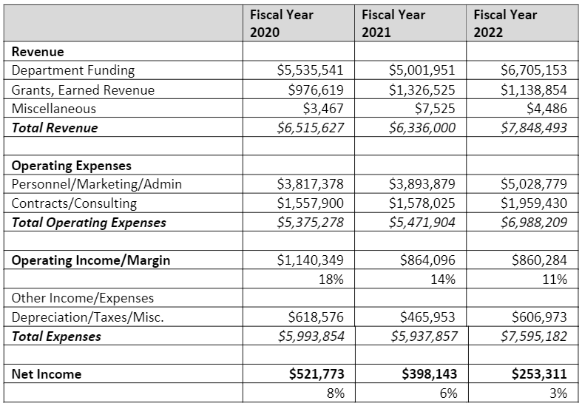
CIVHC Financials, 2020 to 2022
From FY 2020 to FY 2022:
HCPF funding increased by 20%
Personnel, marketing and administrative expenses increased by >30%
FTE up from 27 to 38, a 41% increase. Contracting, consulting expenses up by 25%
Net income down from 8% to 3%
FY | FTE
FY2020 | 27
FY2021 | 30
FY2022 | 38

Slide 34
APCD Funding
 | SFY 2018-19 | SFY 2019-20 | SFY 2020-21 | SFY 2021-22 | SFY 2022-23
HCPF Funding Allocated to APCD | $2,596,500 | $5,535,500 | $5,002,000 | $6,705,000 | $7,904,000
Percent Federal Funds | 37% | 25% | 37% | 51% | 44%
$$ provided by the state via HCPF to support CO’s APCD has grown by almost 250%, >$5.6M, between SFY 2018-19 to SFY 2022-23. Massive differentiator for Colorado’s APCD sustainability and capability.
Enhanced federal match dollars switch from a 90/10 match to a 75/25 match after projects move from development into ongoing operations, increasing the funding needed from the General Fund allocation to cover the state portion.
In reviewing CIVHC’s financial statements, the APCD funding accounts for approx. 85% of CIVHC’s total revenue in fiscal year 2022. Consider the CIVHC mission/focus/strategy vs the APCD mission.

Slide 35
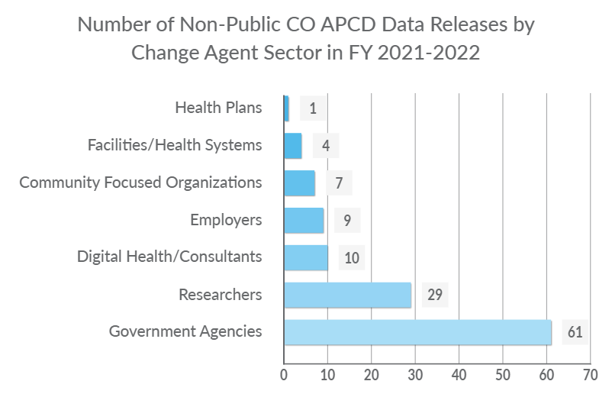
In FY 2021-22, CIVHC generated
121 non-public data releases
50% of releases were for state agencies
~25% for researchers
Remaining ~25% of releases were for digital health consultants, employers, community focused organizations, facilities/health systems, and health plans

Slide 36
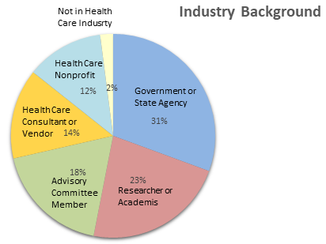
Additional Evaluation Inputs
HCPF distributed surveys to customers who received data and reports in the past 3 years
247 surveys were distributed and 49 were returned (20%)
Interviewed internal HCPF staff who routinely work with CIVHC and receive data from the APCD
Interviewed 3 other states with similar organizational structure as Colorado’s APCD such that the APCD is not directly administered by the state

Slide 37
APCD Administrator (CIVHC) Strengths
81% of customers were satisfied with CIVHC’s customer service, responsiveness to questions about the data or report
77% felt CIVHC delivered useful custom report that provided info requested
77% felt CIVHC public reports address important topics relevant to organization
74% satisfied with promptness of delivery of the data file or the custom report
70% felt CIVHC fully understood their goals
APCD partnership to secure state/fed funding
CO APCD is better resourced and provides access to more meaningful, usable info than other state APCDs
Highly engaged state to support collection of detailed data and reporting from payers

Slide 38
Opportunities for Improvement:
Data Quality and Validation Process
QUALITY
44% (12) of custom report customers and data extract customers agreed and 33% (9) disagreed that they weren’t concerned about the impact of any issues with data quality in the file or APCD limitations on our research or custom report result
Accuracy of the underlying data, opportunities for increased quality checks and completeness of commercial population coverage
Continue to test and evaluate data quality before analysis; explore and test data before developing analytic methods; conduct analyses to ensure complete and accurate results
Seek instruction from experts about validating custom report results
Include specific tests of validity and assessment of validity with clients, stakeholders and experts

Slide 39
Opportunities for Improvement:
Data Analysis Experience, Planning and Customer Experience
If new data elements are collected, CIVHC needs to plan on and test its ability to query and analyze new data, in advance of client inquiries
Leverage State and other expert resources, Intended to improve customer satisfaction, timeliness and accuracy of initial analysis
Continue to refine intake process to confirm outputs and methods with customers during initial intake and planning to better meet the needs of the customers and to avoid rework

Slide 40
Opportunities for Improvement:
Increase APCD Utilization, Value and Affordability
41% (11) of respondents agreed they were satisfied with the cost and value of CIVHC’s data file and custom report and support services, while 19% (5) disagreed, and another 41% (11) neither agreed nor disagreed
Evaluate the model to calculate the cost of custom report development to drive affordability and usability
Provide more transparency in pricing structures to customers, HCPF, and the Advisory Committee for discussion and opportunities identification
Work with employers and other purchasing orgs to increase awareness and utilization of the state’s APCD, given the decreasing rates of custom report utilization
Work to create standard, low-cost reports that employers can access to gain comparative affordability and related insights leveraging the state’s APCD

Slide 41
Opportunities for Improvement:
APCD Funding, Strategy and Opportunity Prioritization
Protect the state and federal funding to maintain the APCD’s ability to meet needs
85%, or $6.7M, of the $7.84M funding is through HCPF
Work with HCPF, the Advisory Committee, and the Board Chair to modernize the APCD strategy
Opportunities identified in this 5-Year Evaluation
Include the prioritization of opportunities and budget projections needed to address prioritized opportunities
Evaluate opportunities, challenges and possible remedies that address gaps between demand and available funding streams
Continue to evaluate the true cost of operating the APCD and ensure CIVHC’s short- and long-term financial plans and staffing levels align with the APCD’s missions, goals and strategies.

Slide 42
Opportunities for Improvement:
Recognizing and Meeting Evolving Demands
Expand value-based payment and other alternative payment model data insights and reporting
Increase capture of self-insured employer data to ensure robust data for credible reporting and analysis purposes — esp. in rural where largest employers are self-insured
Improve ability to capture and evaluate the impact of high-cost specialty drugs
Work with the Department to address the need to capture and report on emerging payments for social determinants of health care by Medicaid and other payers
Review the number of users by public report to consider the potential for focusing on reports used most often and to further maximize their usefulness and accuracy
CIVHC’s continued collaboration with the APCD Advisory Committee to plan the release of future public reports is recommended

Slide 43
Opportunities for Improvement:
Mission and Organizational Structure
Collaborate with the CIVHC Board Chair, HCPF, and the APCD Advisory Committee to revise the recently changed CIVHC mission to better reflect the original legislative directives of the APCD
Include CIVHC Board members representing State Agencies in Executive Sessions held during CIVHC Board meetings
Work with HCPF, the CIVHC Board Chair, and the APCD Advisory Committee in articulating the role of the APCD in CIVHC’s strategic plan
Including aligning the strategic plan with the legislative requirements and objectives of the APCD

Slide 44
Additional Discussion

Slide 45
Appendix
Evaluation Data

Slide 46
Key Observations: Timeliness
74% (20) of respondents reported they were satisfied with the promptness of delivery of the data file or the custom report
15% (4) of customers were unhappy with the timeliness of receiving the reports

Slide 47
Key Observations: Understanding of Business Needs
70% of respondents reported they agreed that CIVHC fully understood their business and analytical goals and rationale for requesting a data file
Some customers commented that they were able to work very closely with CIVHC to receive the data that meet their needs.
4 respondents commented that the lack of CIVHC understanding of their business needs can lead to useless data
This theme also came up in multiple internal HCPF staff interviews
Suggestions included having a more thorough initial intake to better understand each project to improve efficiency and avoid unnecessary revisions at the end of a project

Slide 48
Key Observations: Usefulness
64% of data extract customers agreed the data file was complete, reliable, and useful
38% of public report users agreed public reports “help inform my health care decisions/decisions of my organization”
78% of APCD Advisory Committee responses agreed public reports are timely, meaningful and useful
89% of APCD Advisory Committee responses agreed published reports are simple, intuitive and easy to understand
56% of APCD Advisory Committee responses neither agreed nor disagreed that public reports of health care quality and performance measures stimulate improvements in care delivery and inform decisions by customers, public and private purchasers, and policymakers
3 customers commented that public facing dashboards generated by CIVHC are easy to use
Small number of customers shared it was difficult to interpret data and use without more context and documentation suggesting it would be helpful for reports to be written more user-friendly for those unfamiliar with APCD data
173% increase in public reporting by CIVHC between 2018 and 2023 (15 to 41)
Effort to expand accessibility through infographics, free downloadable data files, and other public products
Improve access to the information CIVHC creates from the CO APCD
Reduce the financial threshold to access CO APCD data

Slide 49
Insights on volume, utilization, and attendance for various public webinars
Month | Data to Drive Decisions Webinar | Registered | Attended
Jul-22 | Shifting from Fee-for-Service in CO | 157 | 84
Sep-22 | Using Data to Reduce Low Value Care | 71 | 36
Jan-23 | Telehealth in Colorado | 111 | 50
Feb-23 | Provider Payment Tool | 93 | 46
Apr-23 | Health Equity Analysis | 111 | 59
May-23 | The Community Dashboard | 98 | 40
Sep-23 | Best Practices and Challenges in Addressing Low Value Care | 89 | 35
Oct-23 | Curbing Prescription Drug Costs in CO | 113 | 62
 | Average | 105 | 52

Slide 50
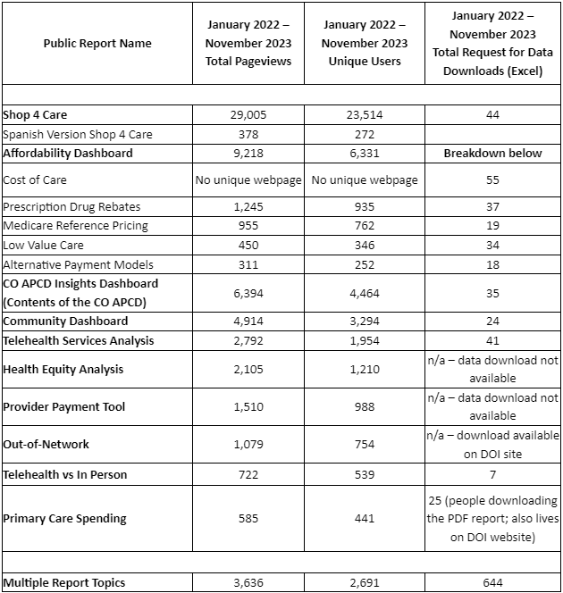
Opportunity to review the number of users by report to consider focusing on reports used most often to further maximize their usefulness and accuracy
Recommend CIVHC collaborates with the APCD Advisory Committee and HCPF to plan the release of future public reports
HCPF recognizes and is working with CIVHC leadership to balance and prioritize the demands for various analysis and reporting with available funding, while identifying opportunities for additional funding

Slide 51
Key Observations: Documentation and Accessibility
64% of data extract customers agreed downloading the data file was easy and efficient and agreed that CIVHC provided a useful data dictionary
57% of data extract customers agreed they received useful information about data table structures and relationships
62% of custom report customers agreed they received sufficient and useful documentation about the methodology and APCD data caveats
36% (5 individuals) neither agreed nor disagreed
6 individuals commented they did not see documentation related to the requested report and requested a useful data dictionary, definitions and associated values, methodology and how to use or interpret data
Some customers commented that it would be helpful to have more documentation of any underlying data issue, such as any submitter issues

Slide 52
Key Observations: Data Quality and Validation of Analyses
86% (12) of data extract customers agreed they received sufficient and useful info about data quality and limitations regarding the absence and delays of data
54% (7) of custom report customers agreed and 23% (3) disagreed CIVHC provided sufficient documentation about validating custom report results for accuracy
65% (17) of custom report customers and public report customers agreed and 19% (5) disagreed they trust the accuracy report results
Two APCD priorities include data quality and the capture of the broadest claim pool, including VBPs and self-funded employer data
Increases data credibility, accuracy and quality reporting insights
Continued focus on increasing submissions from self-insured employers is critical, especially in rural communities

Slide 53
Key Observations: Customer Service
81% (22) of custom report customers or data extract customers agreed they were satisfied with customer service and responsiveness to questions
54% (7) of public report customers agreed that CIVHC is effective in promoting their findings from public reports and prompting me to access the reports
69% (9) of public report customers agreed that CIVHC provides useful info about reports that “helps me understand why the report was produced and what the results mean”
89% (8) of ACPD Advisory Committee responses agreed that CIVHC providers useful info to help consumers and stakeholders understand why report was produced, what results mean, and how results can be used
Most customers commented CIVHC’s customer service was very good or has improved recently

Slide 54
Key Observations: Value
41% (11) of respondents agreed they were satisfied with the cost and value of CIVHC’s data file and custom report and support services
Customers expressed appreciation for the APCD scholarship funds, some of whom commented that it would be difficult to justify the cost of datasets without the APCD scholarship
Others stated that there was not a lot of transparency in the pricing structure of the data reuse and refresh fees, which was almost the same as the initial request

Slide 55
Key Observations: Organizational Structure
Operational oversight on the intake of data and number of reports generated using APCD data is superior to other states
Staffing is significantly higher than the other APCDs, in line with CIVHC’s increased reporting levels
CO APCD staffing has increased from 27 to 30 to 38 (FY 2020, FY 2021, FY 2022)
Staffing levels allow CIVHC to perform functions internally that other APCDs do not perform or rely on contractors
CIVHC’s internal operations to manage the APCD and contractors is superior to other APCDs
CIVHC can leverage highly engaged state partners to drive the collection of detailed data
Given the importance of the CIVHC Board, and 85% APCD funding from the State, HCPF is requiring the inclusion of CIVHC Board members representing State Agencies be included in Executive Sessions held during CIVHC Board meetings

Slide 56
Key Observations: Mission
Most recent mission statement has evolved away from the directives of the founding APCD legislation and the interests of the State
In Aug. 2023, CIVHC changed its mission to the following: “To equip partners and communities in Colorado and across the nation with the resources, services, and unbiased data needed to improve health and health care.” This replaced the previous mission: “We strive to empower individuals, communities, and organizations through collaborative support services and health care information to advance the Triple Aim of better health, better care and lower costs.”
The APCD’s established directive, as memorialized in 25.5-1-204 is: “facilitating the reporting of health care and health quality data that results in transparent and public reporting of safety, quality, cost, and efficiency information; and analysis of health care spending and utilization patterns for purposes that improve the population's health, improve the care experience, and control costs.”

Slide 57
Key Observations: Funding
In SFY2022, CIVHC received 85% of its $7,839,840 in revenue through HCPF, including both state and federal funding
Other APCDs don’t have the funding levels or direct policy and regulatory support from the state
Protecting this unique funding stream will help CO maintain the state’s APCD, advance the APCD’s ability to meet the evolving needs of users and address the opportunities identified in this evaluation

Slide 58
Key Observations: Evaluating the Complexities of Health Care
HCPF and CIVHC have worked to expand data collection from payers via the Data Submission Guide (DSG) and regulations
Including the collection of prescription drug rebates, VBPs, and refinements to improve quality analytics and ease of submission for payers
CIVHC has struggled to efficiently, effectively, and accurately analyze emerging areas in the last year, including rebates, VBPs and high-cost specialty drugs
HCPF is working with the CIVHC Board Chair and leadership to recognize that if new data elements are collected, CIVHC needs to plan on and test its ability to query and analyze new data
HCPF is engaging to leverage State and other expert resources to help CIVHC through this planning process, intended to improve customer satisfaction, timeliness, and accuracy of analysis from new payer data sets

Slide 59
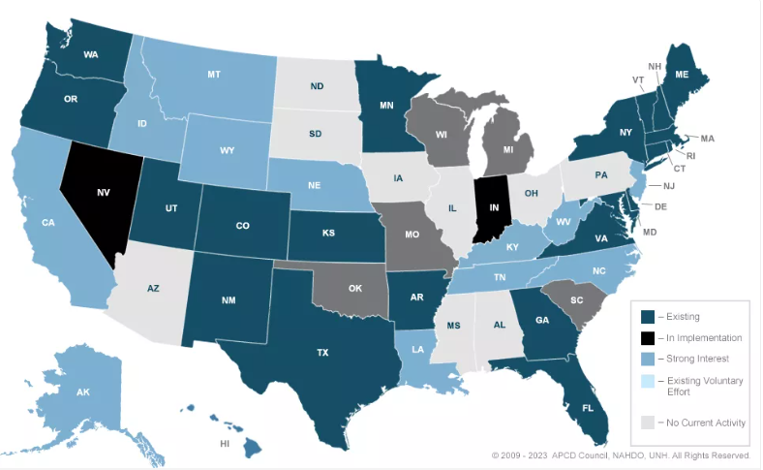
22 existing and 3 implementing APCDs nationwide

Slide 60
Agenda
Opening Announcements
Operational Updates
HCPF 5-Year CO APCD Evaluation & Discussion
Public Reporting
Public Comment and Member Open Discussion

Slide 61
Public Reporting
Cari Frank, MBA
VP of Communication and Marketing
Clare Leather, MPH
Public Reporting Program Manager

Slide 62
Public Reporting Releases
Recent Releases
Provider Payment Tool
Telehealth Equity Analysis
Telehealth vs In-Person Payments and Claims Denials Analysis

Slide 63
Upcoming Public Reporting Releases
Quarter 3 (Jan-March)
Wildfire and Ozone Impact on Health
Firearm Injury Analysis
Drug Rebate Analysis
Medicare Reference Based Pricing
Quarter 4 (April-June)
Shop for Care
Community Dashboard
CO APCD Insights Dashboard

Slide 64
Public Report Usage July 2023 – Feb 2024
Total
FY average pageviews per month: 2508
FY average unique users per month: 1745

Slide 65
Telehealth Equity Analysis
Goal: Understand the relationship between social factors in U.S. Census data and use of telehealth visits and in-person visits that could have been delivered via telehealth using information in the CO APCD.
Use Cases:
Understand how telehealth and in-person visits differ across the state and by county and neighborhood.
Investigate which social factors have a relationship to high or low use of in-person or telehealth services for your community.
Develop programs or initiatives to support increased access to telehealth or in-person services, specifically addressing social factors impacting your community

Slide 66
What’s Included? Social Factors
Data from the Census American Community Survey
% of Individuals: People of Color, Veterans, Limited English, Disability, Unemployed, Without a H.S. Diploma
% Households Without: Internet, Computer, Smartphone
*Note: the CO APCD does not contain Veterans Administration (VA) data

Slide 67
What’s Included? Health Care Measures
Data from the CO All Payer Claims Database
Telehealth Utilization is defined as the number of visits for any reason (any diagnosis), recorded in claims as telehealth
Number of telehealth visits per 1,000 people in the CO APCD
In-person Utilization is defined as the number of in-person visits (identified using the same set of CPT codes used above).
Number of in-person visits per 1,000 people in the CO APCD
In-person services were limited to ONLY services that COULD have been performed via telehealth and do not include things like surgery or lab tests that require an in-person visit.

Slide 68
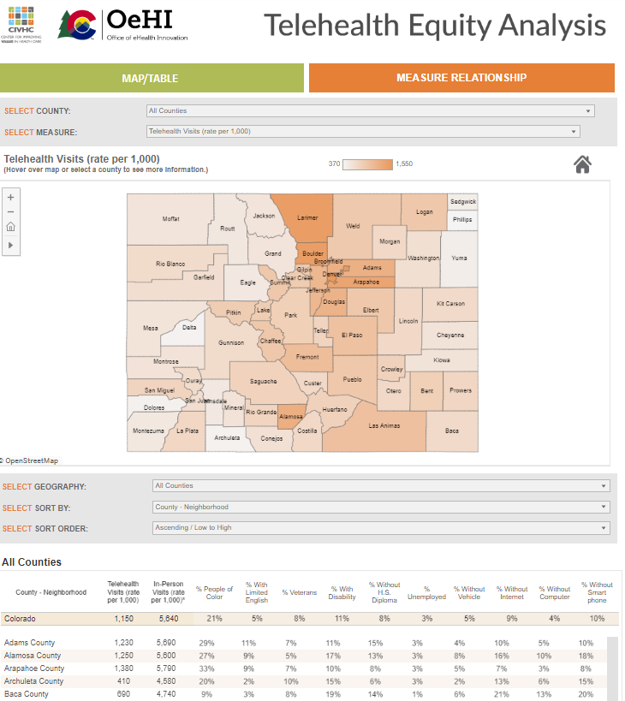
civhc.org > Get Data> Public Data> Focus Areas >Telehealth Analyses> Telehealth Equity Analysis
The first tab (map and table view), allows you to select a geography and service category or social factor of choice.
The second tab (relationship view), shows the relationship (if any) between individual social factors and both in-person and telehealth use.

Slide 69
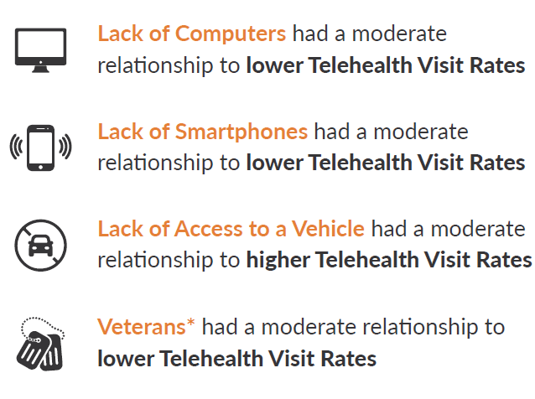
Insights and Findings
Statewide Insights

Slide 70
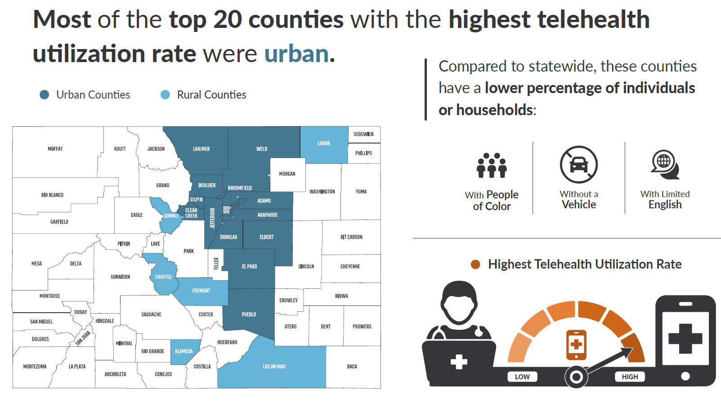
Insights and Findings

Slide 71
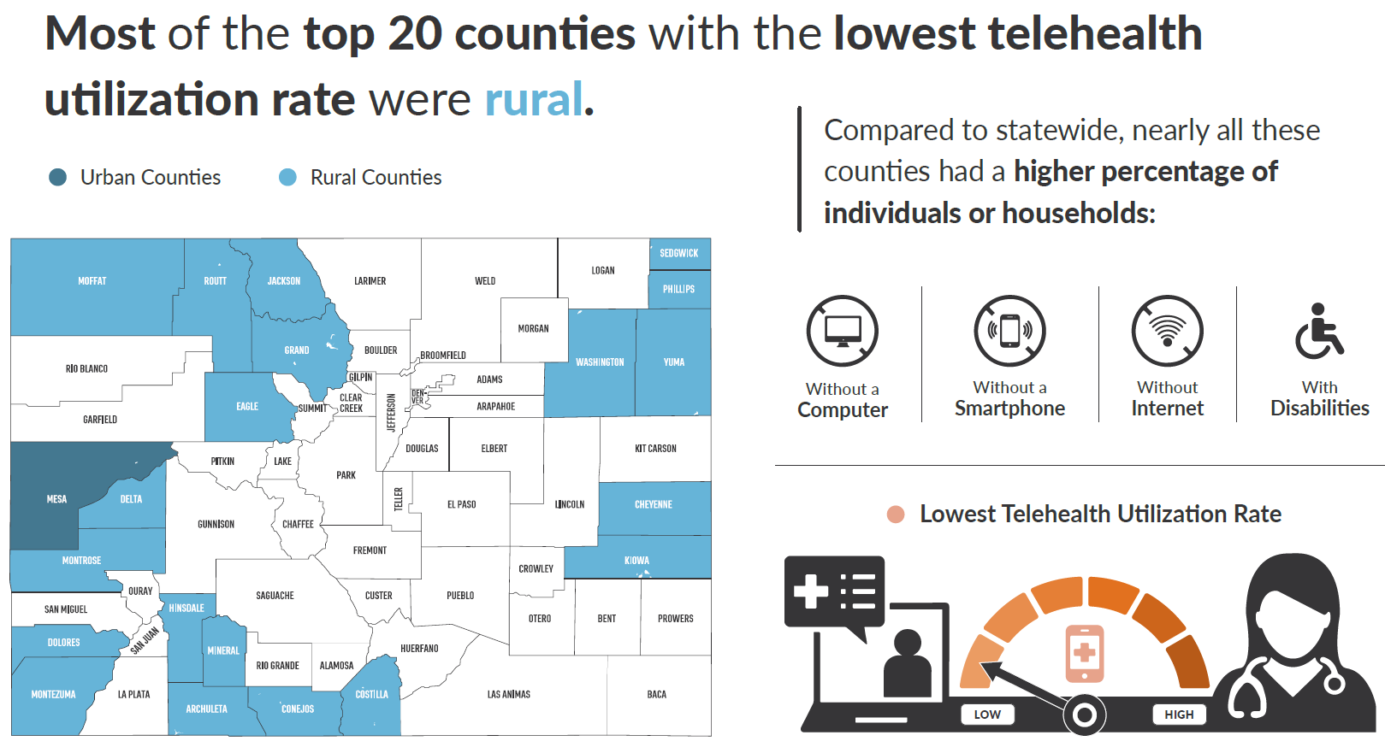
Insights and Findings

Slide 72
Telehealth vs. In-Person Services Payment Variation Analysis
Goal: Utilize CO APCD claims data to determine if there is, in fact, payment equality between in-person telehealth services.
Methodology: Compared median and interquartile ranges of allowed amounts.
Analysis was comprised of nine generalized linear models and included place of service (telehealth vs. in-person) as the primary variable of interest.
Data analyzed included 8.6 million total claims across 27 commercial payers.

Slide 73
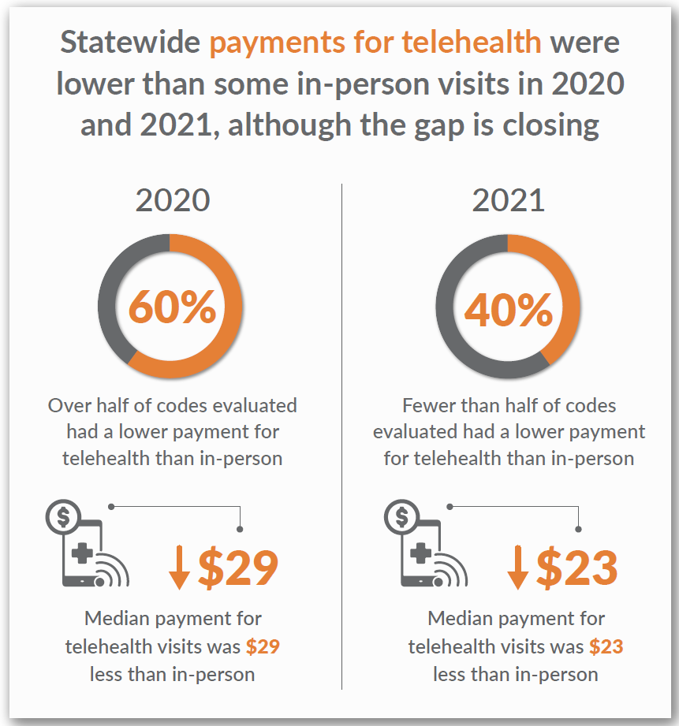
Telehealth vs. In-Person Services Payment Variation Analysis
Insights and Findings

Slide 74
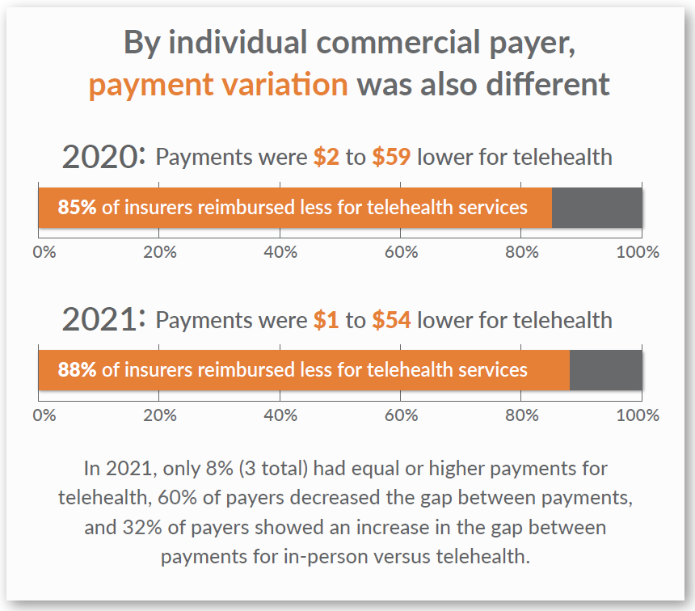
Telehealth Payment Variation Analysis
Insights and Findings

Slide 75
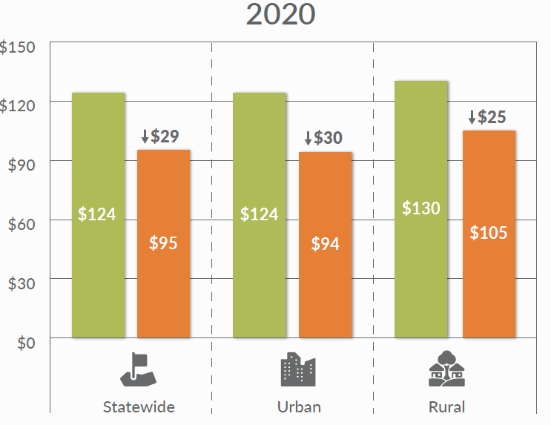
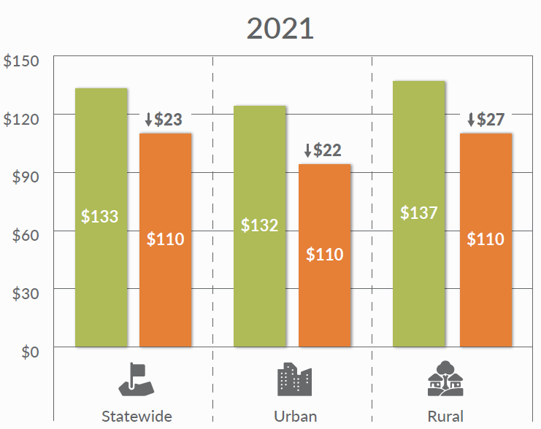
Telehealth Payment Variation Analysis
Insights and Findings
The payment gap was larger in urban areas in 2020 and in rural areas in 2021.
Notes:
Urban and rural indicator is based on member’s residence. In general, there was a significantly higher reimbursement rate for rural telehealth claims compared to urban telehealth claims.

Slide 76
Telehealth Claim Denial Analysis
Goal: Assess whether there is parity between the rate of claims denial between telehealth and in-person services.
Methodology: Issued a data call to five commercial health insurance companies requesting individual claim lines for services delivered in 2020 and 2021.
Explanations for reduction or denial were grouped into themes
Chi-squared tests of independence were performed to compare the distribution of claim denial reasons
Logistic regressions were then performed to determine whether the place of service influenced the odds of a claim being denied by company, service type, or geography.

Slide 77
Claim Denial Analysis
Insights and Findings

Slide 78
Agenda
Opening Announcements
Operational Updates
HCPF CO APCD 5-Year Evaluation & Discussion
Public Reporting
Public Comment and Member Open Discussion

Slide 79
Member Discussion & Public Comment

Slide 80
2024 Meeting Schedule
June 11, Sept 10, Dec 10
2pm-4pm
Virtual unless otherwise noted

